Slide 1

MICRSOFT 365
How the file system and Outlook have changed

Slide 2
File System Changes
How your One Drive is the same as your P Drive
  This is still your personal space
  It will still follow you just like your P drive did from machine to machine
  You should still save to this space rather than your desktop, stuff on your desktop is not backed up so you are taking a risk if you save there or to your documents folder
  We can still help you make changes to it
    I.T. can still help you make changes or move things around in your One Drive if you need us too.

Slide 3
File System Changes
How your One Drive is different than your P Drive
  These files are stored in the cloud.
    The cloud is not some magic storage bin, it is just what people call a storage space that exists out on the internet. So technically it can be accessed from anywhere, and we are working on securing that so that so that can be a reality.
    HIPAA has to be addressed before we can do that
  The files you see are stored in two locations though you only see one
    A local copy is on the C drive of the machine you are working from is located at C:\Users\sbreedlo\OneDrive - hcrs.org, the other is out on the internet

Slide 4
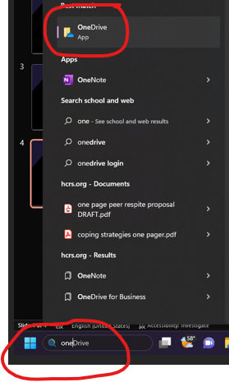
File System Changes
What do these changes mean to you, what is going to be different
  First it means that accessing your One Drive requires an additional sign in once you are logged into your computer
  This is done by going down to the search box next to your start button and typing the word One and then selecting ONE DRIVE from the options

Slide 5
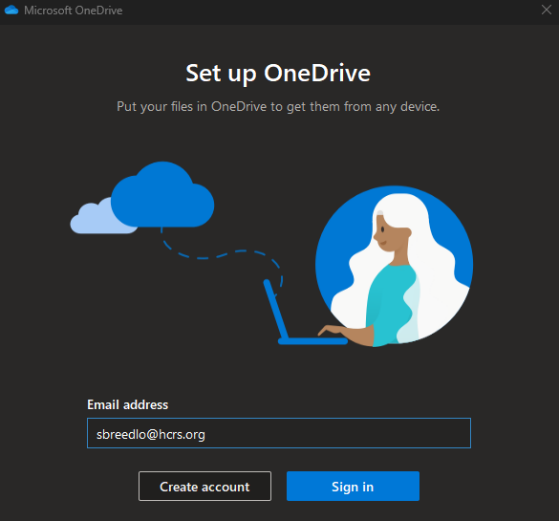
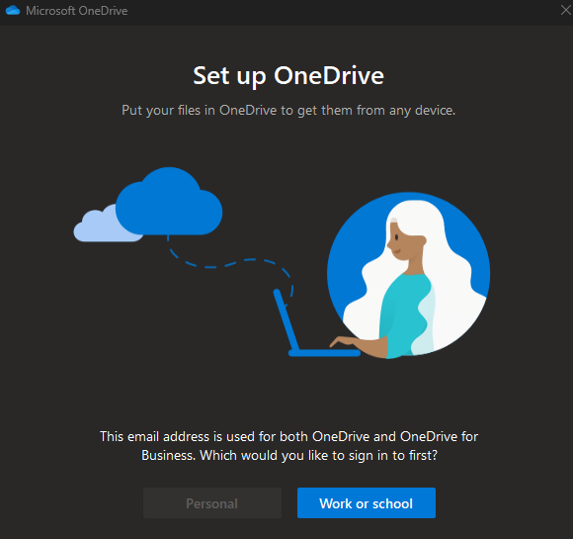
File System Changes
You will be prompted for your email address please fill that in and click sign in
You will then be prompted for your password (this is the same password you use to sign into your computer or Horizon)
Last you will be asked if this is for work/ school or personal. Whenever you are asked this please always answer work/school

Slide 6
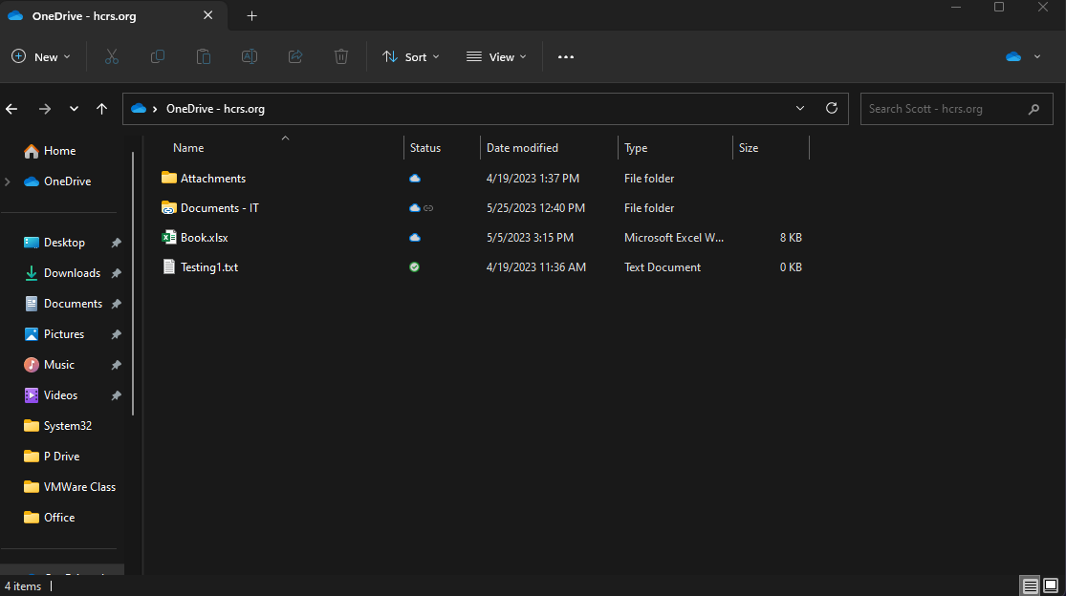
File System Changes
You should get a window in file explorer that looks like the one on the right hand side of this slide
You will also see an icon in the lower right hand side of the screen that indicates One Drives status:
  In addition to the all good icon and not connected versions of the icon you see here this icon can also appear with green arrows or a red indicator.
    The slash means you are not connected to one drive
    The green arrows means it is actively syncing the local version of the drive and cloud drive
    The Red indicator means you have a sync problem probably due to a file name issue.

Slide 7
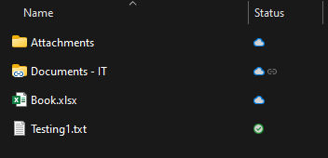
File System Changes
There is a lot going on, on that File Explorer page, what do all these new icons mean?
The file labeled attachments looks like a standard file folder and it is, the icons you see there indicate it is only a file for me
The file labeled Documents – IT looks a bit different though and that is because that is actually a short cut to a file that exists on Sharepoint. You can actually create a shortcut to all the files that used to exist on the S drive so that you can get to them really easily (We will cover that in a bit)

Slide 8
File System Changes
There is a lot going on, on that File Explorer page, what do all these new icons mean?
Last we need to look at the Status field.
  The cloud means you only have one copy of this file and it exists online. When you click to open and edit a file like this it will download a copy to the local computer and then open it.
  The green checkmark means you actually have two copies of that file, one on the computer and one online. When you open a file like this it is saving to your local machine and then it will synchronize to the cloud, so that both files are identical once you are done with your edits

Slide 9
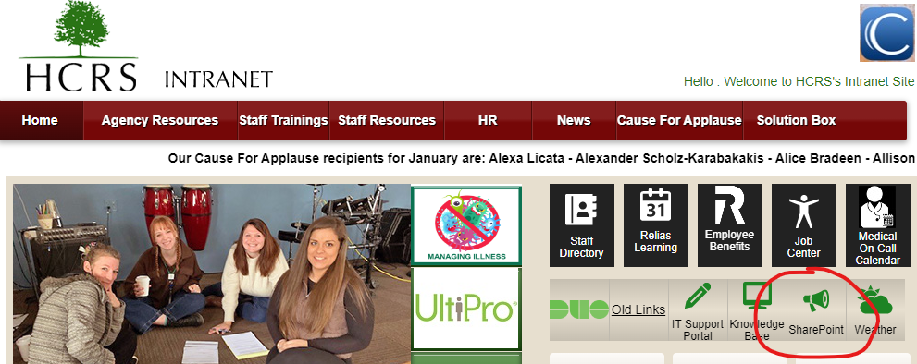
File System Changes
How do I create a shortcut to my One Drive
  All the stuff that was once on the S Drive now exists out on Sharepoint, the easiest way for you to access that data is with a shortcut
  You can create a shortcut by going to the intranet page and selecting the Sharepoint icon

Slide 10
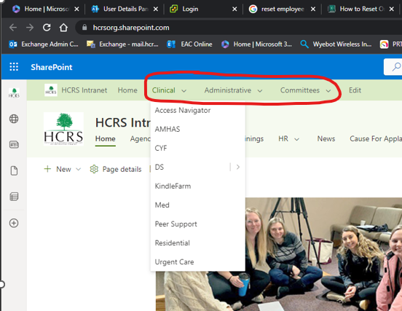
File System Changes
How do I create a shortcut to my One Drive
  On the Sharepoint site select your department or committee from one of the drop down menu’s

Slide 11
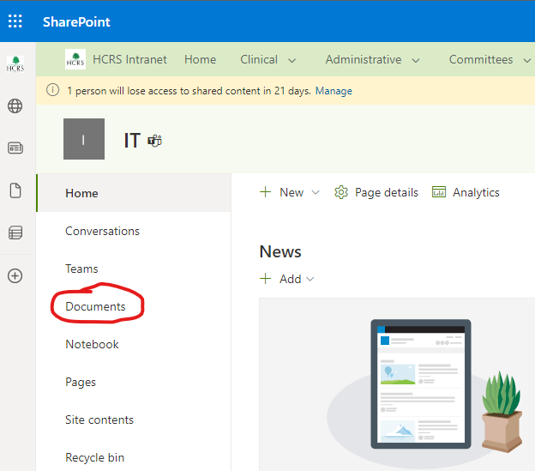
File System Changes
How do I create a shortcut to my One Drive
  Once you select your department click the documents folder

Slide 12
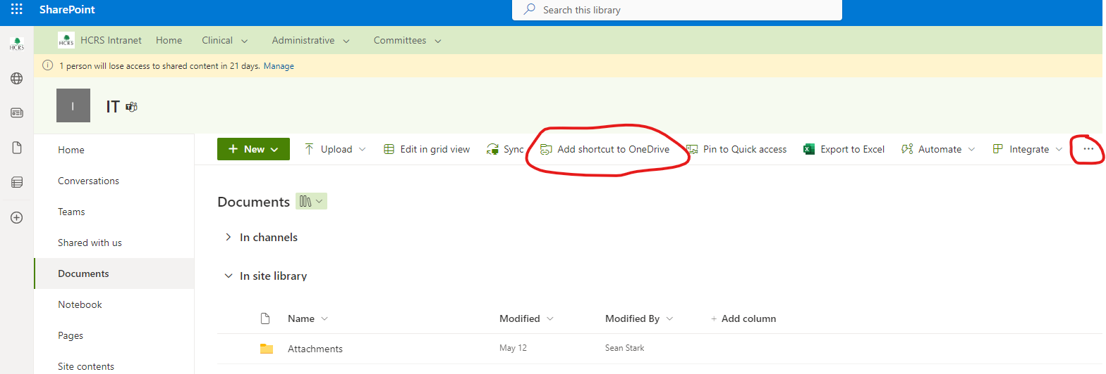
File System Changes
How do I create a shortcut to my One Drive
  From the menu at the top of the right hand side of the page select “Add shortcut to One Drive” (if this option is not visible hit the three dots on the far right side of the page and the option should be there)

Slide 13
File System Changes
  After a couple of minutes your shortcut will show up in One Drive just as you saw on the earlier example.
  With Shortcuts you can scan or save directly to the Sharepoint sites
  Now you might be saying to yourself this doesn’t look like what I am used to seeing now. All my stuff opens inside of Chrome and looks completely different…
  That is because all of these programs and features have online versions.

Slide 14
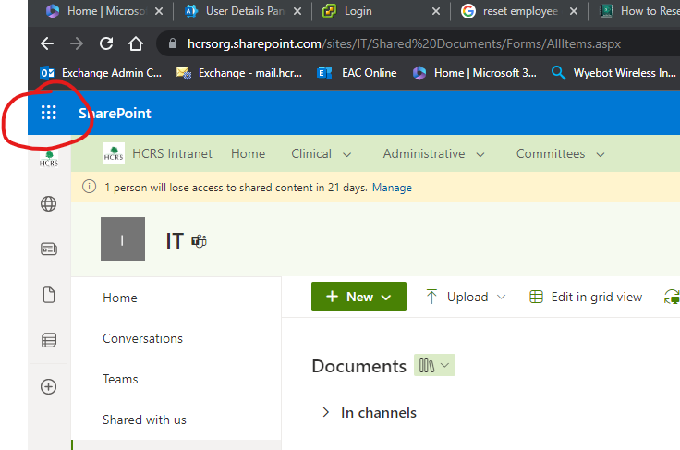
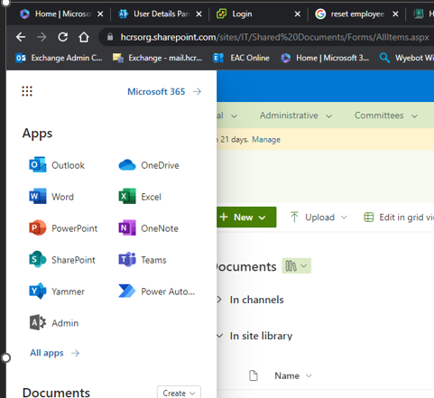
Online Versions
There are online versions of every office program
  They are accessible from Sharepoint by clicking on the waffle icon in the top left corner of the screen or by going to portal.office.com
  Even One Drive is available this way

Slide 15
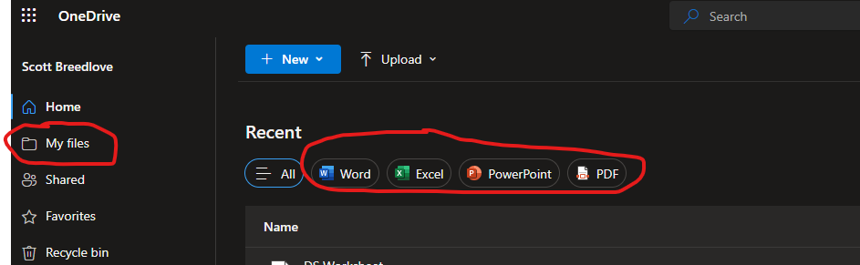
Online Versions
The view for One Drive is significantly different
  Initially what you will see is a list of files you have recently accessed.
  You can sort this by clicking the options at the top of the screen to show recently viewed files for specific applications
  If you click on My files to the left side of the screen you will get a more traditional file view

Slide 16
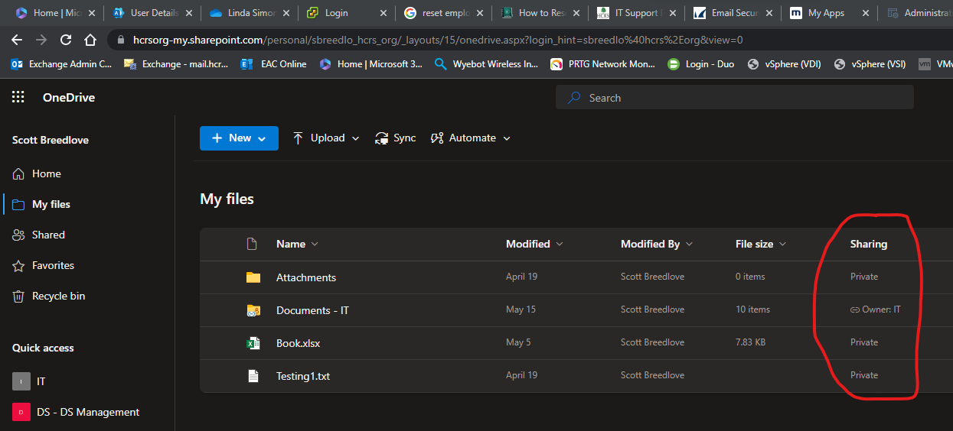
Online Versions
The view you see on this page will show you everything you have stored in your One Drive in addition to all your shortcuts.
  This view of One Drive also gives you a handy column that gives you sharing details so you can tell at a glance what is private and what is shared with others

Slide 17
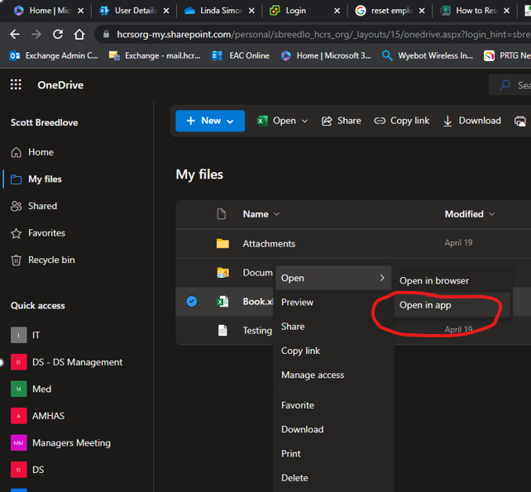
Online Versions
Anything opened from One Drive inside of the Web Browser is going to open by default in the Web Versions of the office programs unless you specifically tell it to open via the installed APP on the computer. This is done by right clicking the file you are opening and hovering over open until the sub menu appears to tell it to open via the APP

Slide 18
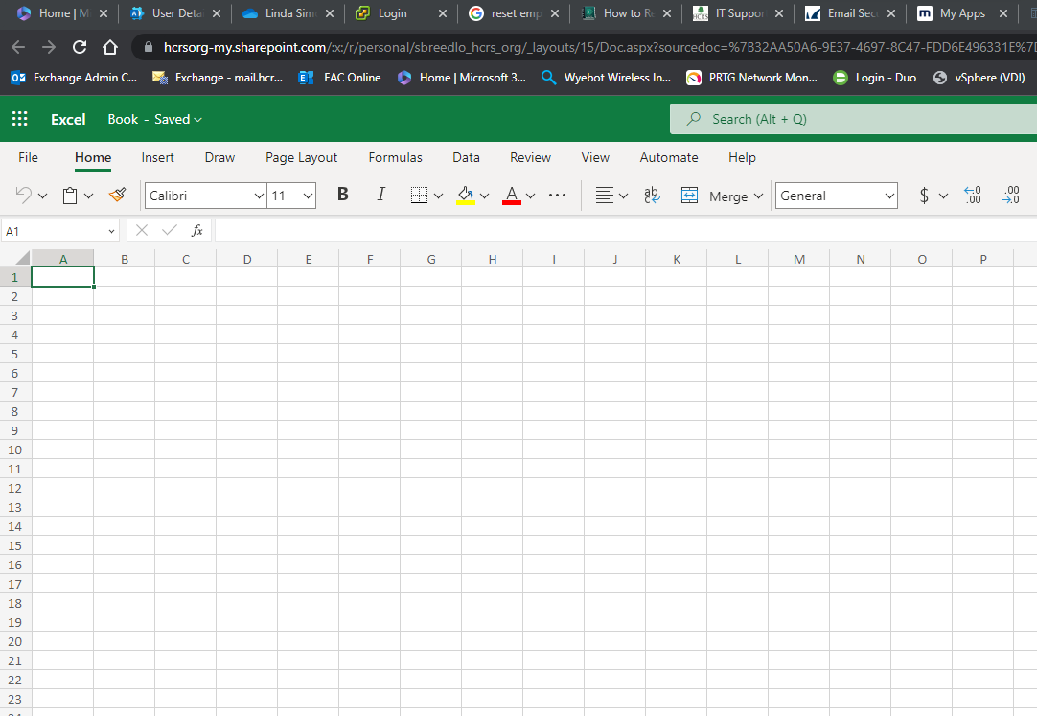
Online Versions
Things to note if you do decide to use the Web Apps (Outlook, Word, Excel, or other)
  For the most part it will work and look exactly like what you are used to using as an APP
  There maybe some stuff though like Macro’s in excel that do not work. This is because the online versions are meant to a quick use kind of version of the program rather than a real replacement for the installed versions of these programs
    Most stuff that you use everyday though will work
  When you go to save only Online options will be available, you will not be able to save to your desktop from the Online Versions of these programs
  You can always tell you are in the online version of the program because it will be open in a tab on Chrome

Slide 19
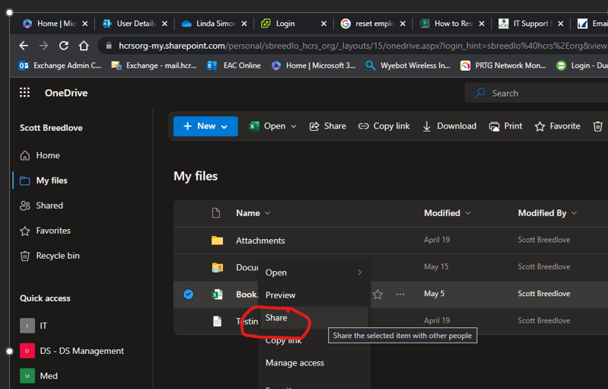
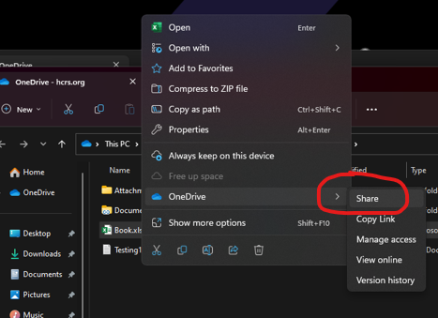
Sharing Files
Sharing from your One Drive (or anywhere else really)
  From the web environment you would simple right click the file and select share (as shown to the right)
  From File Explorer you would right click select One Drive then Share (as shown below)

Slide 20
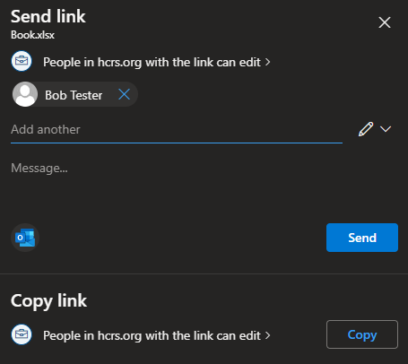
Sharing Files
Sharing from your One Drive (or anywhere else really)
  Just add whomever you want to share with via their email address, you can add more than one email address at a time and click the send button

Slide 21
Sharing Files
Something to be careful of when sharing folders.
  Files save automatically as you work on them
    This means that if you have shared a file then go back into the file and make edits, those edits are going to be shared as you make them.
    So if you share a file then go edit it and then save it manually with a new name and think that no one but you can see those edits, you have made an error.
    What you have actually done is make edits to the original file and saved it as that original file then created a copy of that file with a different name, so whoever you shared that file with originally can see your edits
    Best practice is to open the file you want to edit, save it as a new copy of the file with a new name that is not shared right out of the gate, then make your edits, this will prevent accidental sharing

Slide 22
Shifting Gears to Outlook
Some stuff has changed in Outlook that may effect your ability to find your email.
The first setting we are going to look at is Focused mail
With new Outlook email gets broken down into Focused Mail and Other.
Why it does this no one but Microsoft knows, what the criteria is for how it does this, again no one but Microsoft knows but lets discuss how to turn this incredibly useless “feature” off

Slide 23
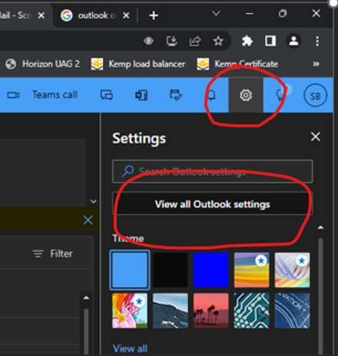
Shifting Gears to Outlook
In the online version of Outlook, once you are signed in go to gear that is next to your sign on name in the upper right corner

Slide 24
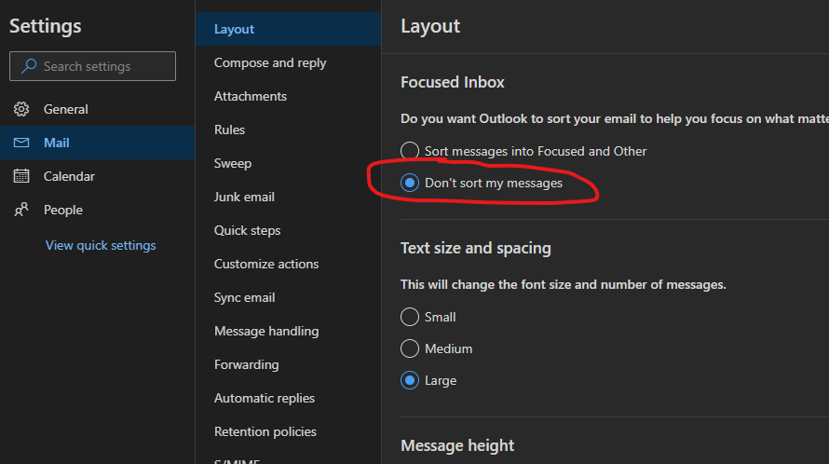
Shifting Gears to Outlook
Once this opens go to Mail then Layout then the Very First option you are going to click the circle for “Don’t sort my messages”

Slide 25
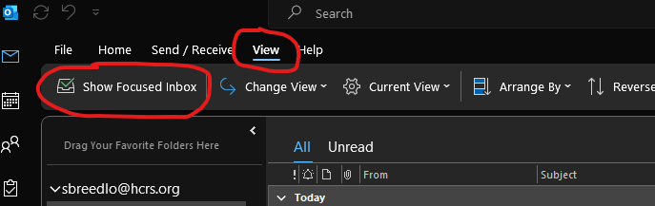
Shifting Gears to Outlook
To change this setting in the in the local Program for Outlook you would go up to view, then click off the Show Focused Inbox option.

Slide 26
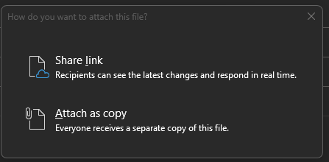
Shifting Gears to Outlook
Attaching a file is a little different too when attaching a file you will get the same file selection screen you have always gotten but after selecting the file you will get a new prompt to send as a copy or a link
If you select a link you are in fact Sharing that file with anyone you are emailing that file too
If you select Attach as Copy then you are just creating copies of that file to attach as a copy to the email.

Slide 27
For more help
We will be doing more trainings on other issues as it becomes apparent what folks are struggling with but if you need more help right now please check out these options:
  Go to https://quickhelp.com/ and use your HCRS email address and password to access tutorials
  Email us at IT@hcrs.org
  Call us at extension 2294 (if calling from outside the agency please use 802-886-4567 and then dial the extension)

