Slide 1
Horizon with DUO

Slide 2
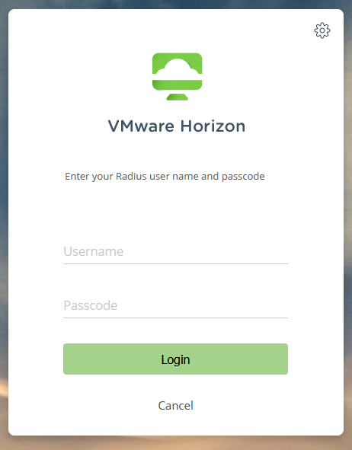
Horizon in a Web Browser
Most of this is the same as you are used too.
When you go to horizon.hcrs.org the biggest change you might notice is that the verbiage has changed on the logon screen
  The password fields description has changed to Passcode
    You will still just use your regular user name and password here.
You are actually logging into a Radius Server at this point

Slide 3
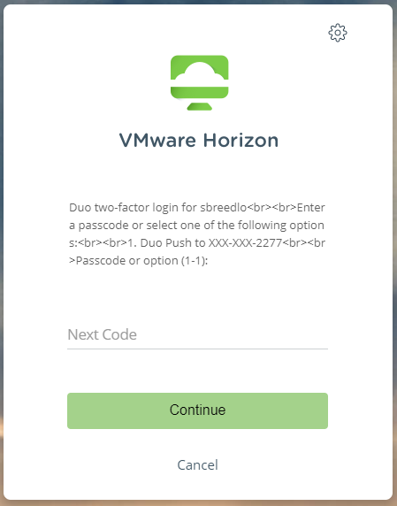
Horizon in a Web Browser Continued
You will then get a prompt asking you how you want to Authenticate.
  If you press one and hit enter you will get a prompt on your phone asking for you to authenticate your log in (As shown on next slide)
  Or you can enter the passcode from your Token

Slide 4
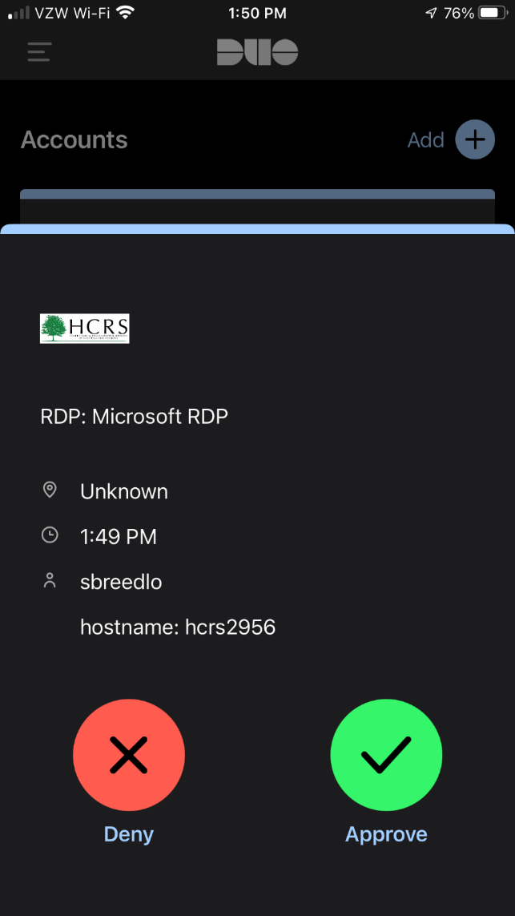
Horizon in a Web Browser Continued
You will then get the usual prompt on your phone if you authenticate that way

Slide 5
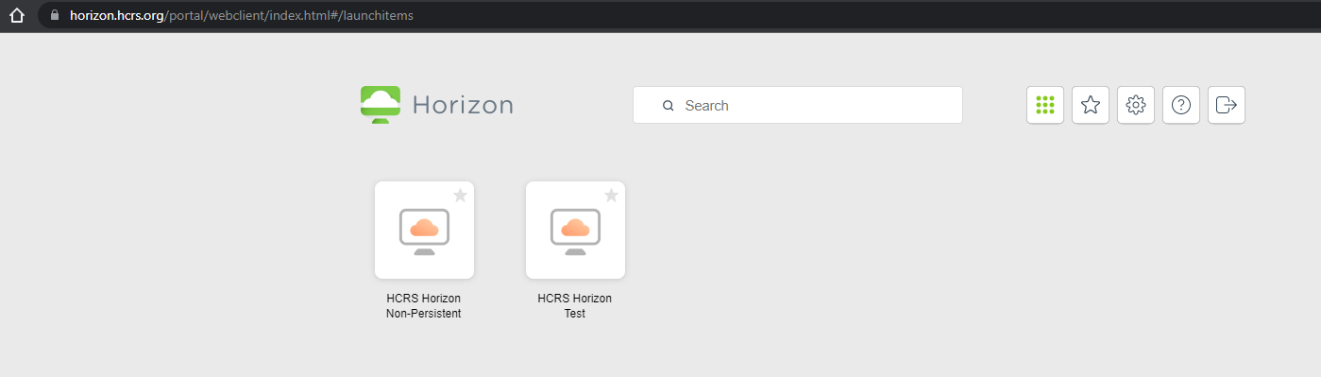
Horizon in a Web Browser Continued
After this point you will see your usual options for selecting a virtual desktop and you can proceed as you usually would.

Slide 6
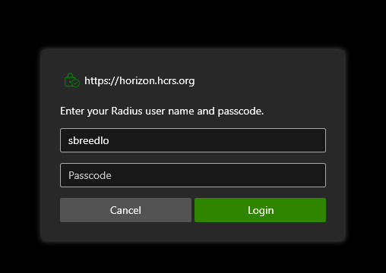
Horizon via the Client Program
This also works very close to what you are used too.
Again the biggest change you might notice is that the verbiage has changed on the logon screen
  The password fields description has changed to Passcode
    You will still just use your regular user name and password here.
You are actually logging into DUO at this point

Slide 7
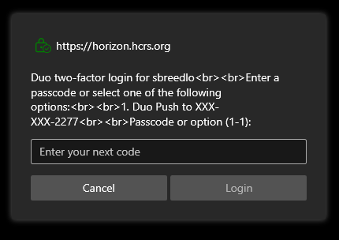
Horizon via the Client Program
You will then get a prompt asking you how you want to Authenticate.
  If you press one and hit enter you will get a prompt on your phone asking for you to authenticate your log in (As shown on next slide)
  Or you can enter the passcode from your Token

Slide 8
Horizon via the Client Program
You will then get the usual prompt on your phone if you authenticate that way

Slide 9
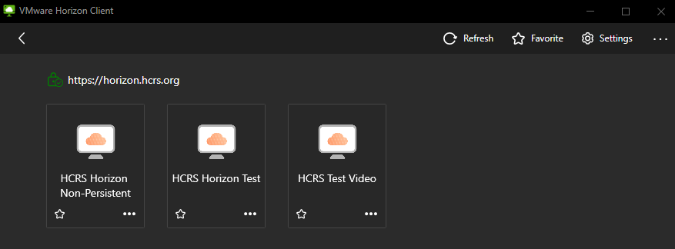
Horizon via the Client Program
After this point you will see your usual options for selecting a virtual desktop and you can proceed as you usually would.

Slide 10
Last Slide for this section
It’s time for questions?
Afterwards if anyone needs help enrolling I am also happy to go over that power point as well and walk you through that process.

